Slide 1
Team Name- CODE BRIGADE Project Name- AFFIXITY
Members-
Anjali Silawat (anjalisilawat2004@gmail.com)
Aritra Mondal (sasuke.aritra.sa@gmail.com)
Rakshit Gondwal ( rakshitgondwal3@gmail.com)
Raghav Goel (goelraghav01@gmail.com)

Slide 2
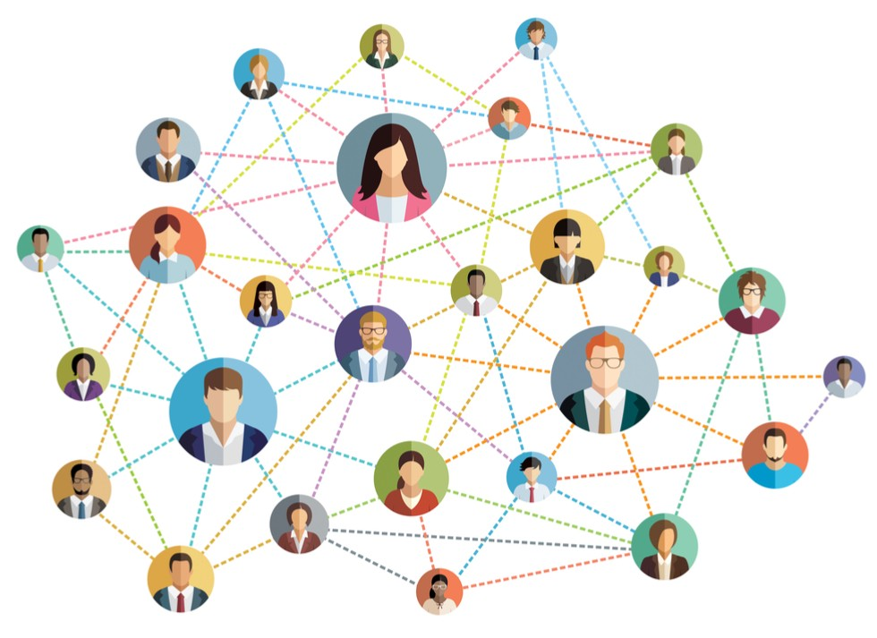
Problem Statement- An online platform for university students to connect with each other
Description-
College students face difficulties in finding like minded seniors or alumni from whom they can connect and take guidance. This platform helps students to connect and their seniors from their university

Slide 3

Solution-
To tackle this problem. We’re going to build an online platform in which students would be able to connect and chat with the seniors or alumni or their batchmates from their university.
We are going to sort the students based of their graduation year and then show a list of all the students present in a specific year.
Students will be able to create their profiles and add their socials to their profiles. Through this, other students would be able to connect on other social platforms too.
There are platforms available like LinkedIn but these platforms don’t provide us with the sorted list of students from a specific year. By creating this website, we are going to help the students and especially freshers, as they find it very difficult to find good seniors or good alumni to connect with.

Slide 4
Demo/working-
1. When someone lands to the website, they would see an authentication or a login/register page at the first.
Here, they would be able to create their own profile and their info like a simple bio, socials, education etc. This whole data would be saved into a database which would help us sorting the students.
2. After this they would be redirected to the main page of the website. The main features of this page would be-
A list of the students present in their own university
My profile
Chat box
3. When someone clicks on the list section, they will be redirected to a list in which they can filter out students on the basis of their graduation year. By this they will get a sorted list of the students present in a specific year.
They will be able to click on any student and the student’s profile will show which would show the bio, socials and other stuff related to that student.
4. If someone clicks on the my profile, they would be redirected to the my profile section in which they would be able to edit the own profile settings and other personal details.
5. If someone clicks on the Chat box, they would be redirected to a chat section in which they would be able to ask any doubt or ask any query related to anything. This would be visible to every student present in that university and anyone would be to reply to that question.

Slide 5
Business model
For a business model, we could show ads on the website and generate revenue from that.
We can also ask for donations such as buy me a coffee or something. Ultimately, if we don't ask, we don't get.

Slide 6
Market-
The market is pretty huge in this area. Almost every student or almost every fresher looks up to search for their seniors on various platforms such as LinkedIn, Whatsapp groups etc, but they don’t find the proper senior as there is no specific platform at which they can get a sorted list of their seniors, alumni or their own batchmates.
Thus a typical customer persona for this would be the university students.

